Slide 1

EO@BC2 –
A robust bunch length monitor
Comissioning and first results of a possible standard diagnostic tool
Laurens Wissmann
Bernd Steffen, Jonas Breunlin
EO@BC2 – A robust bunch length monitor
FLASH seminar, 2011-12-20
Notes:
Hello everybody….
- Present work on a bunch length monitor installed behind BC2
Work done by Jonas Breunlin, Bernd and me
Jonas wrote his diploma thesis on this

Slide 2
Outline
Basics
  The electro-optic effect, measurement setups
  Electro-optic spectral decoding
Setup
  Schematic
  Laser system and laser synchronisation
  Electro-optic frontend, electronics
Results
  Establishing Overlap
  Data acquisition, time calibration
  Long range scan, low charge capability
  Beam shape measurement vs. LOLA, resolution limitation
Upgrade
  Exchange of EO crystal, new results, summary
Laurens Wissmann – EO@BC2 – Page 2/18
Notes:
….
KEEP IT SHORT
….

Slide 3
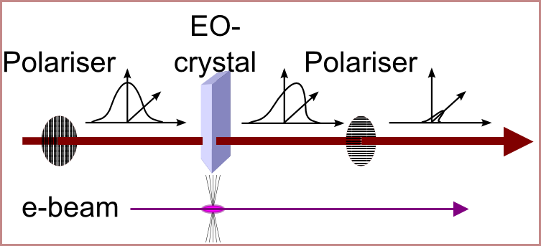
Electro-Optic Effect
Electric field of relativistic electron bunch: THz-pulse in laboratory frame
THz pulse changes refractive index in the EO crystal
Polarisation of a copropagating laser pulse accordingly changes
For example: crossed polariser setting (CP) pictured here
Analyser changes polarisation modulation in amplitude modulation
Laurens Wissmann – EO@BC2 – Page 3/18
Notes:
1. The EO effect describes the fact that some material become birefringent when an electric field is applied to them.
2. Birefringency is modeled as a change of the refractive index of the material.
3. The electric field of an electron bunch that passes by an EO crystal installed in a beam pipe thus changes the refractive index of the crystal.
4. The e-field of an relativistiv electron bunch appears as a THz pulse in the laboratory frame.
5. A laser pulse can be used to sample the changed index of refraction.
6. As an example, the crossed-polariser or CP setting is depicted here.
7. In this setting, a laser pulse travels through a polariser and becomes linearly polarised (drawn as an enveloppe parallel to this polarisation plane), then through the EO crystal, and then through a second polariser that is turned by 90 deg w.r.t. the first one.
8. Two cases, first no electric field/no bunch, then with field.
9 Many different setups have been deployed over time.

Slide 4
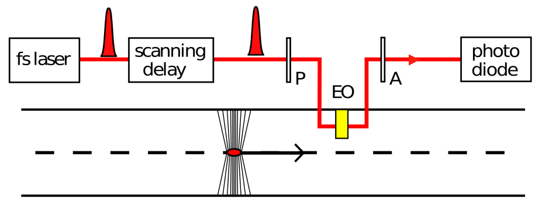
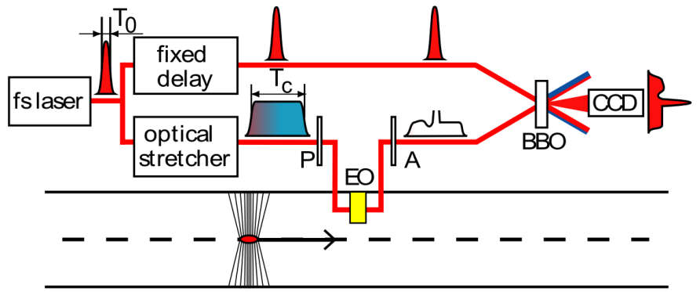
Measurement Setups
EOS – electro-optic sampling
  Least complex
  multishot technique
  low laser power necessary
EOTD – electro-optic temporal decoding
  Most complex
  single shot
  requires ~100 µJ laser pulses
Other – EOSpD, Frequency mixing, etc.
General temporal resolution limitations:
  EO crystal resonances
  Laser pulse length
Laurens Wissmann – EO@BC2 – Page 4/18
Notes:
There is the EOS – multi shot, laser pulse shiftd in time step by step w.r.t. the e bunch and hus samples it,
Not complex, but multi-shot
EOTD – Single-shot, but very complex
Other techniques
Fundamental resolution limitations:
Phonon resonances
Laser pulse length
EOS: Also jitter between laser and ebunch
BUT: We were not aiming for highest temporal resolution!
Requiremtns were:
Single shot, setup not too complex.

Slide 5
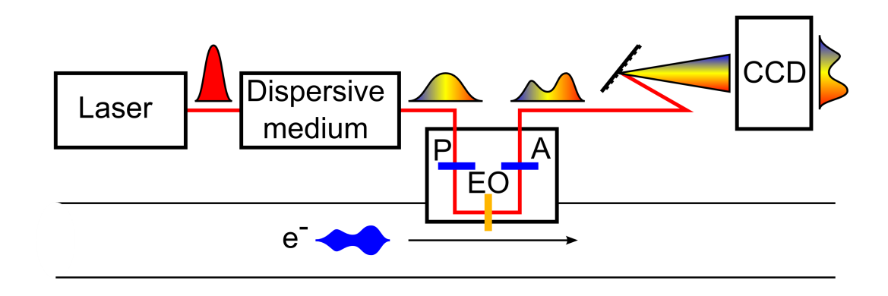
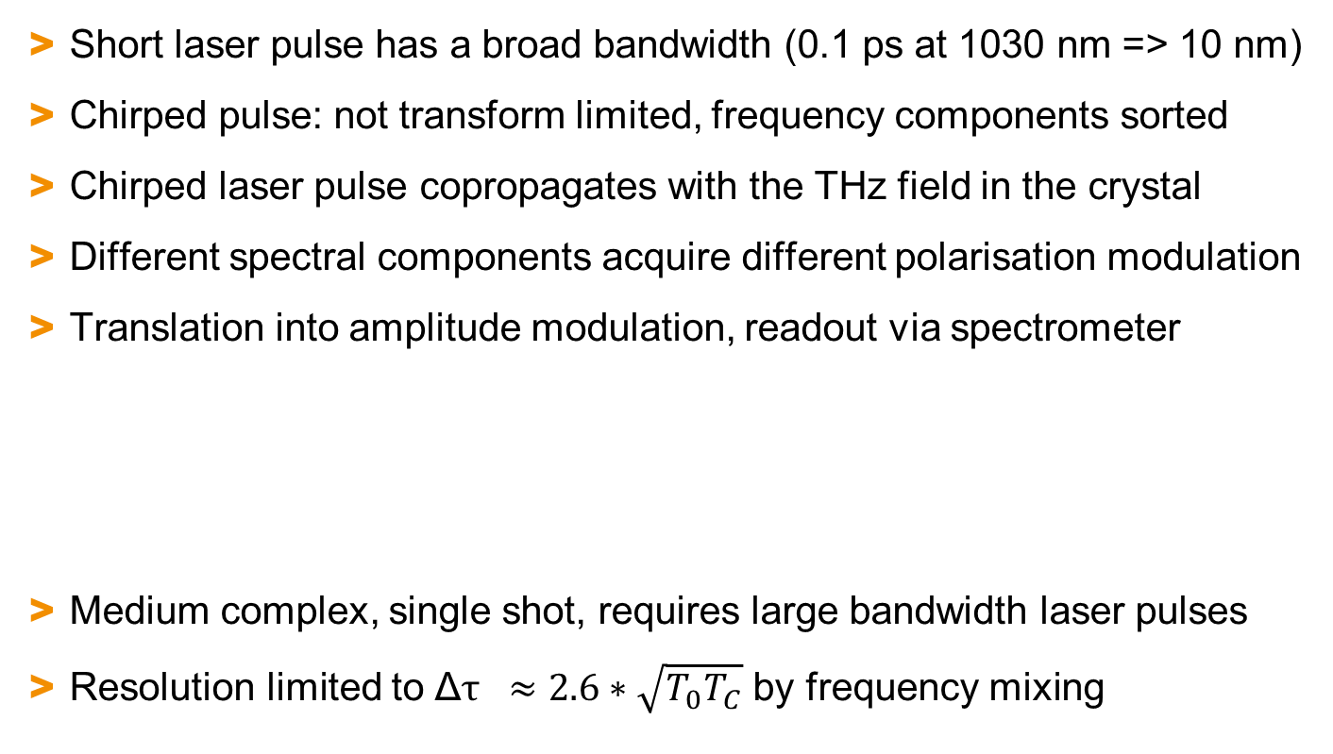
EOSD – Electro-Optic Spectral Decoding
Short laser pulse has a broad bandwidth (0.1 ps at 1030 nm => 10 nm)
Chirped pulse: not transform limited, frequency components sorted
Chirped laser pulse copropagates with the THz field in the crystal
Different spectral components acquire different polarisation modulation
Translation into amplitude modulation, readout via spectrometer
Medium complex, single shot, requires large bandwidth laser pulses
Resolution limited to Δ$τ ≈2.6∗\sqrt{T_{0}T_{C}}$ by frequency mixing
Laurens Wissmann – EO@BC2 – Page 5/18
Notes:
To understand spectral decoding, we need to know what a chirped laser pulse is.
A short laser pulse has a broad spectral bandwidth.
By traveling through a dispersive medium, it becomes longer.
The frequency components become sorted, in result we have a linear relationship between the instantanious frequency of the optical field (the frequency component) and the place in the bunch.
If such a laser pulse propagates through the EO crystal while the electron passes by, the leading frequency components in the pulse acquire a polarisation modulation that is related to the leading part of the bunch, and same for tail.
This setup suffers from the same resolution limitations as the ones shown before, but in adition from an effect called frequency mixing, restricting to much higher values in terms of resolvable bunch widths.
How can such a setup be realised experimentally?

Slide 6
EO@BC2 Setup - Schematic
All components in tunnel
Lead shielded box for
  Laser
  Electronics
  Readout camera (10 Hz)
Remote control on
  Crystal-to-beam-position
  Analyser wave plate setting
  Laser status
  Laser synchronisation
  Laser-to-bunch timing
Laurens Wissmann – EO@BC2 – Page 6/18
Notes:
Everything in tunnel
Go once through:
Fibre laser and ist synch
Pulse train travels through fibre to frontend, is stretched
One pulse is polarisation modulated
Becomes amplitude modulated
Is gated out because camer can‘t handle 108 MHz
Go through YDFL and ist Synch
Show picture of frontend and lead shielded box

Slide 7
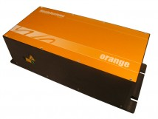
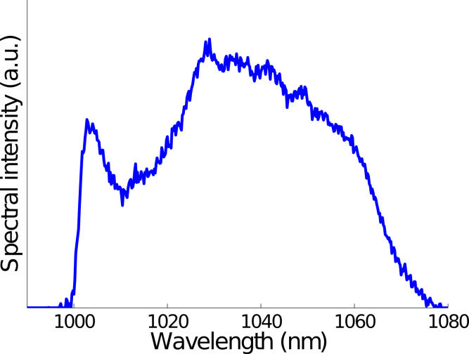
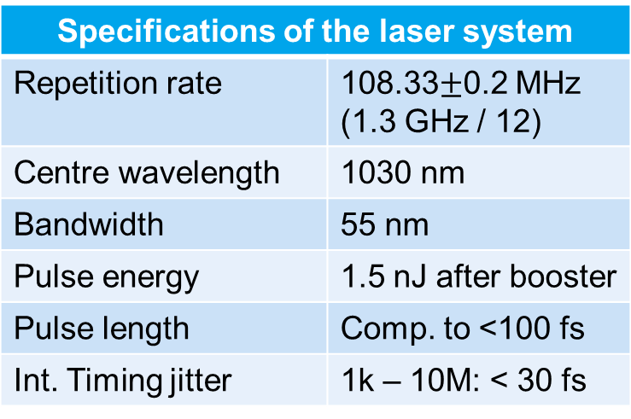

EO@BC2 Setup – Ytterbium Doped Fibre Laser (YDFL)
Commercial system (Menlo)
Ytterbium-doped fibre laser
Very robust design
Virtually no maintainance
Pulse length chirped to $\sim$7 ps
Specifications of the laser system
Repetition rate | 108.33$±$0.2 MHz (1.3 GHz / 12)
Centre wavelength | 1030 nm
Bandwidth | 55 nm
Pulse energy | 1.5 nJ after booster
Pulse length | Comp. to <100 fs
Int. Timing jitter | 1k – 10M: < 30 fs
Laurens Wissmann – EO@BC2 – Page 7/18
Notes:
Commercial system, purchased fraom MENLO
Why this laser?
N opt = N THz
N opt = N opt (lambda)
1 µm centre wavelength
Ytterbium laser good for short pulse sources
Fibre laser good for robustness
Synch is important

Slide 8
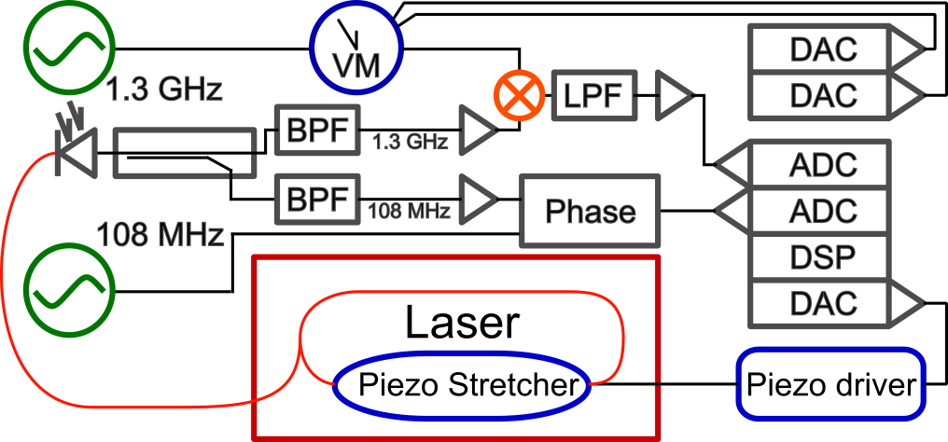
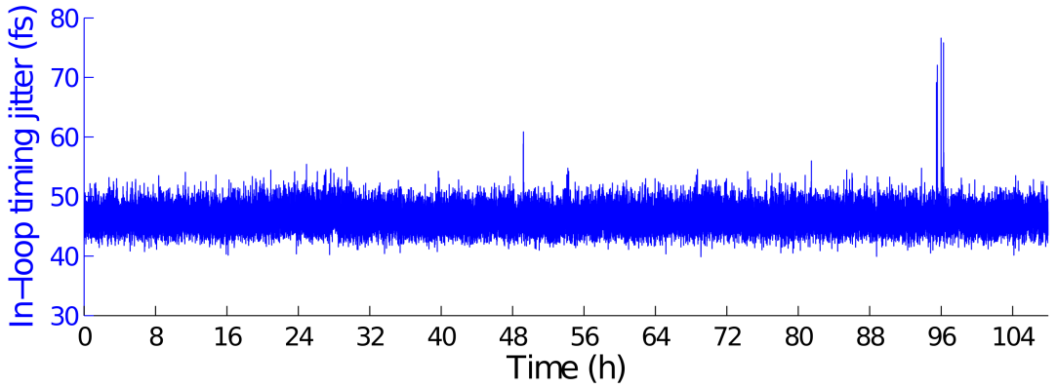
EO@BC2 Setup– YDFL Synchronisation
Temperature stabilised laser
Cavity length adjustment
  Rough: Motor actuator
  Fine: Piezo fibre stretcher
VME based digital control loop
Good long term performance (days, weeks,…)
Laurens Wissmann – EO@BC2 – Page 8/18
Notes:
In-loop jitter corresponds to less than 200 fs jitter between the 1.3 GHz comp of the laser to the MO int from 10 Hz to 10 MHz when measured out of loop.

Slide 9
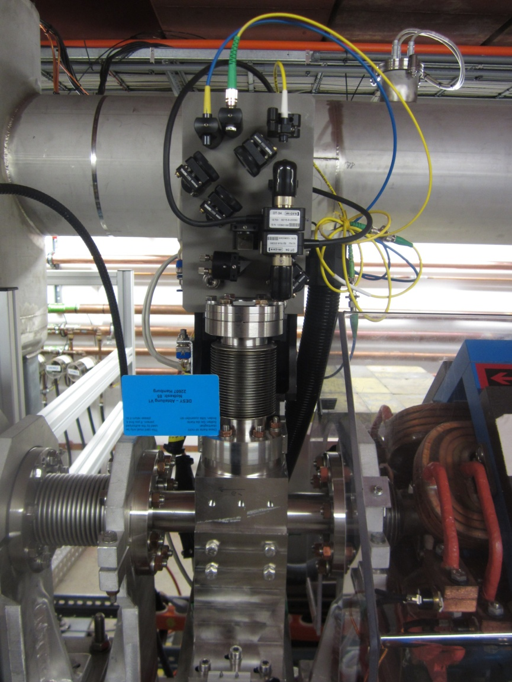
EO@BC2 Setup – The Electro-Optic Frontend
Designed at PSI
Installed during 2010 shutdown
Equipped with all necessary bulk optics
Requires 20 cm beam pipe
Fibre coupled, motorised
Different dive-in depths without adjusting optics
Wave plates motorised
EO crystal: 0.5 mm GaP
Laurens Wissmann – EO@BC2 – Page 9/18
Notes:
KEEP IT SHORT

Slide 10
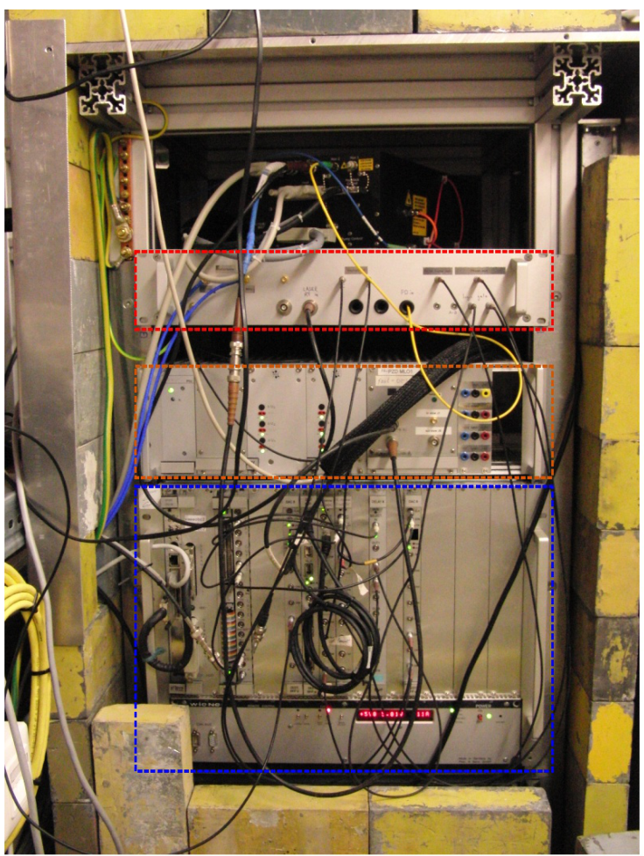
EO@BC2 Setup – Electronics, Trigger, and Readout Box
Lead shielded box with
  YDFL, spectrometer and InGaAs Cam
  RF electronics, AOM
  Power supply unit with piezo driver
  VME crate wih RF lock control running on a DSP, delay cards, ADC`s, trigger enhancement board, AOM driver board
  Laser power supply unit
  95/5 Coupler, Photodiode, RF amplifiers, other stuff
  SRS DG535 for Gate generation
  Fibre length to optical front end: 2 m
Laurens Wissmann – EO@BC2 – Page 10/18
Notes:
KEEP IT SHORT
- How good does this work?

Slide 11
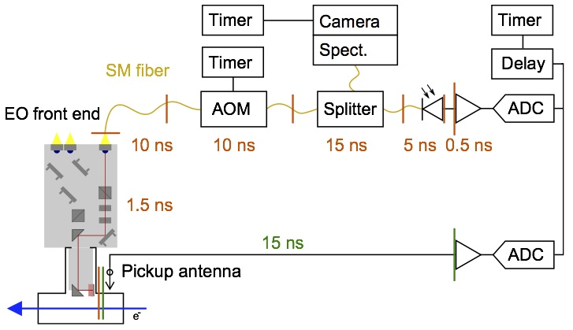
Measurements – Establishing Overlap
Rough timing: compare pick-up antenna signal to laser pulse arrival time
Set correct timer value for AOM and Cam
Fine timing: scan laser in steps of 1 ps w.r.t. bunch, look at camera and PD
Once found, timing does not change much
Laurens Wissmann – EO@BC2 – Page 11/18
Notes:
Key problem to all EO setups: How to establish the temporal overlap
Two step approach

Slide 12
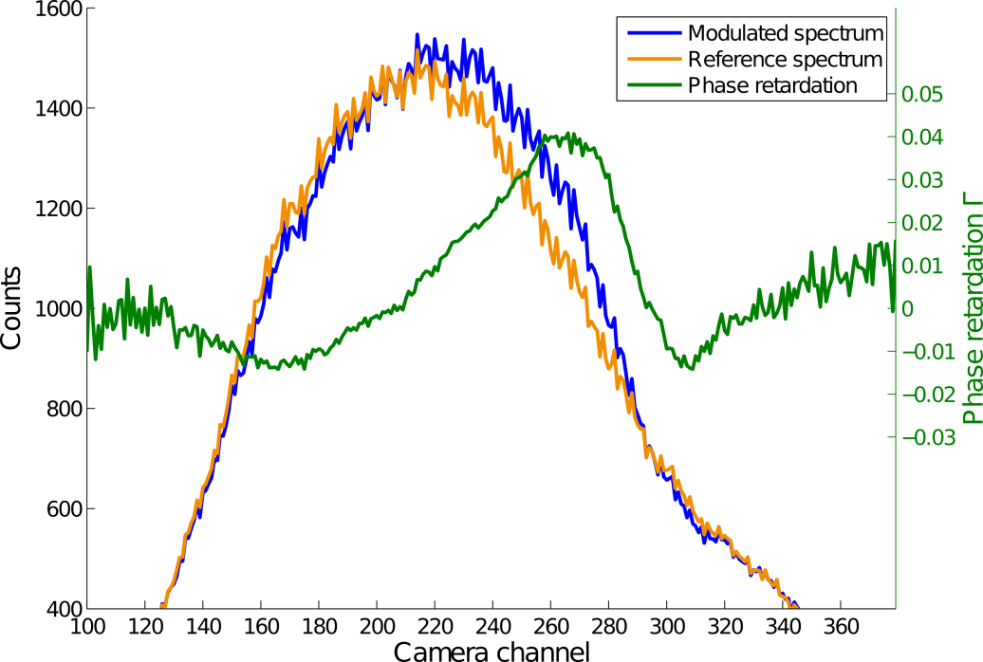
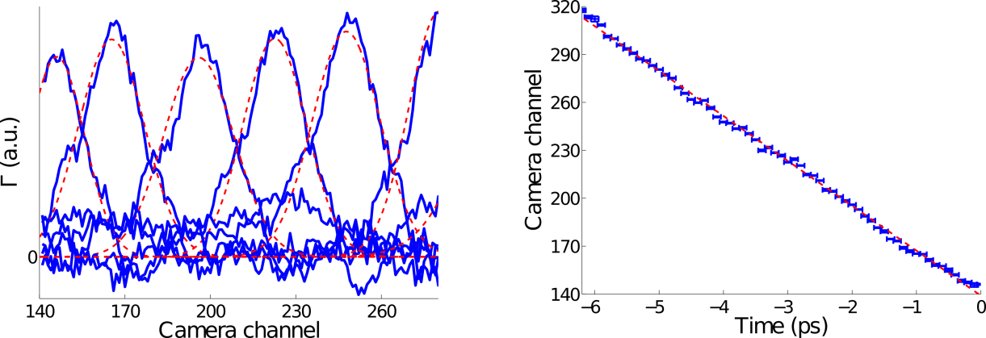
Measurements – Data Acquisition and Time Calibration
Reference spectrum taken
Modulated spectrum taken
Phase retardation is calculated from their relation
Phase retardation is proportional to the THz field strength
Time calibration by shifting the laser with respect to the e-bunch
-28 channel/ps (bunch head on the right)
6.4 ps detector range
Laurens Wissmann – EO@BC2 – Page 12/18
Notes:
Gamma = arccos(1-2Idet/Ilas)-4th
Jitter would lead to a horizontal shift of the signal
Doesn‘t matter for single-shot
In practice, averaging is done to increase signal-to-noise ratio
Having established the time axis, a long range scan can be done

Slide 13
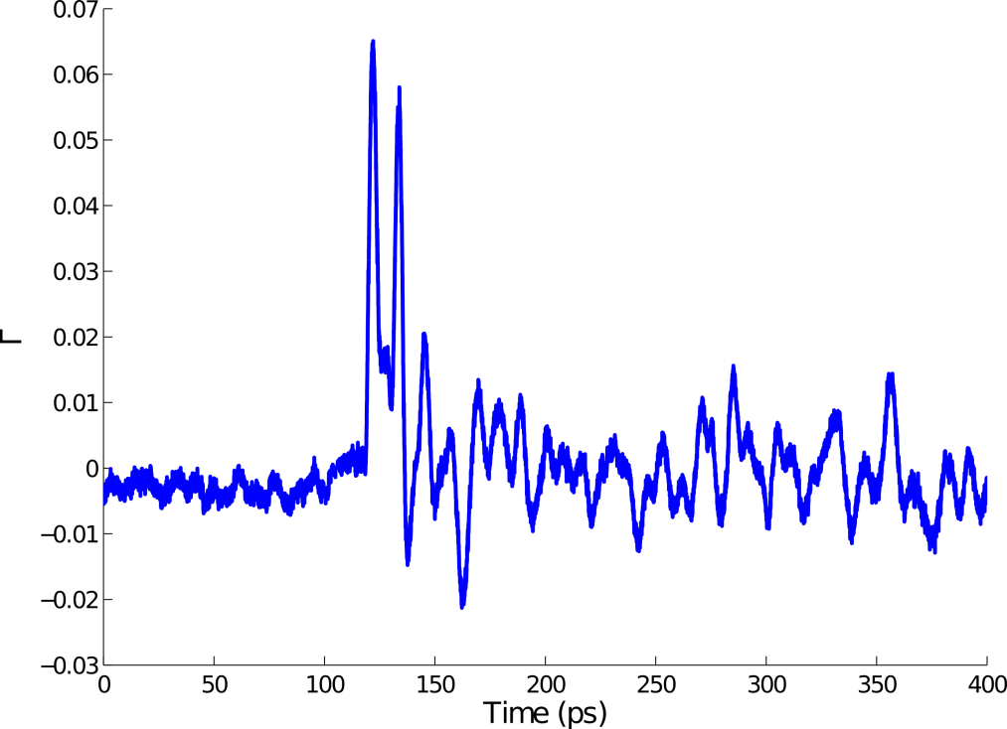
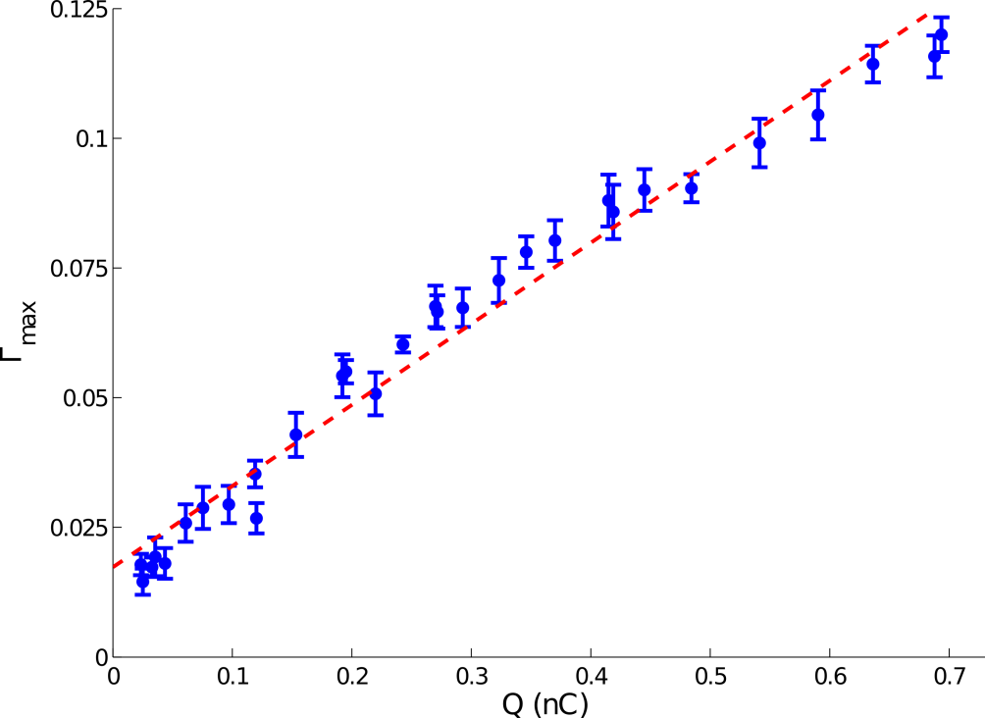
Measurements – Long Time Scan, Low Charge Ability
Subsequent sets of data, concatenated after requiry
Clearly visible artifact at 11 ps due to reflection in EO crystal
Ringing for several hundred ps
Signals for bunch charges as low as 50 pC have been measured
Laurens Wissmann – EO@BC2 – Page 13/18
Notes:
Signals averaged and merged.

Slide 14
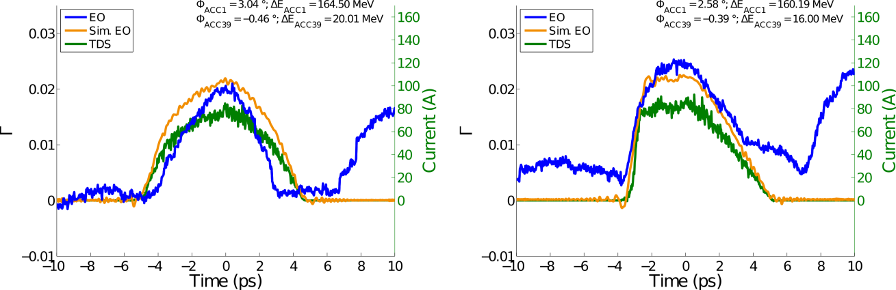
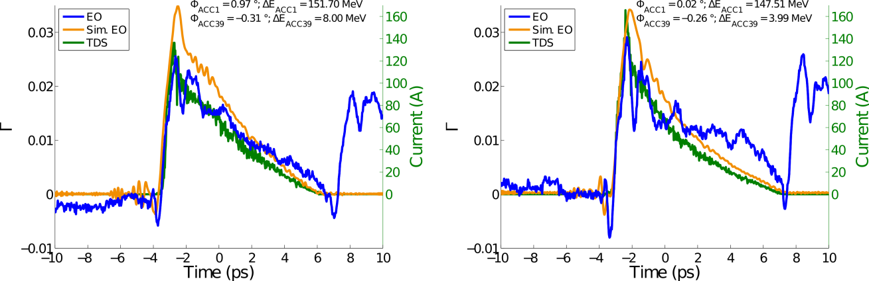
Measurements – Bunch Shapes: EO@BC2 vs. LOLA
Straight through BC3, measure same bunch
Good agreement in shape measurement of ordinary bunches
Oscillations occur when a steep edge is produced
Laurens Wissmann – EO@BC2 – Page 14/18
Notes:
Benchmarking the monitor against TDS
Go straight through BC3 for this.
Green: EO, blue: LOLA
For rather bunches with a linearised phase space (top row), good agreement.
For steep edges, oscillations

Slide 15
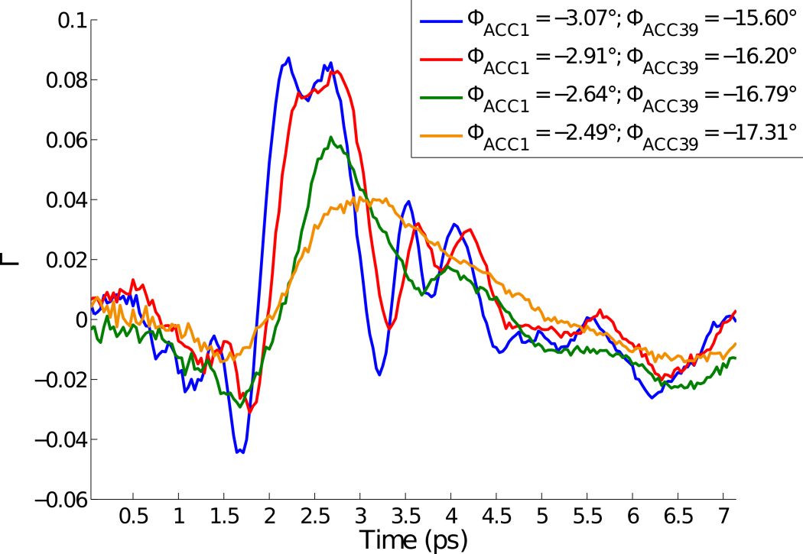
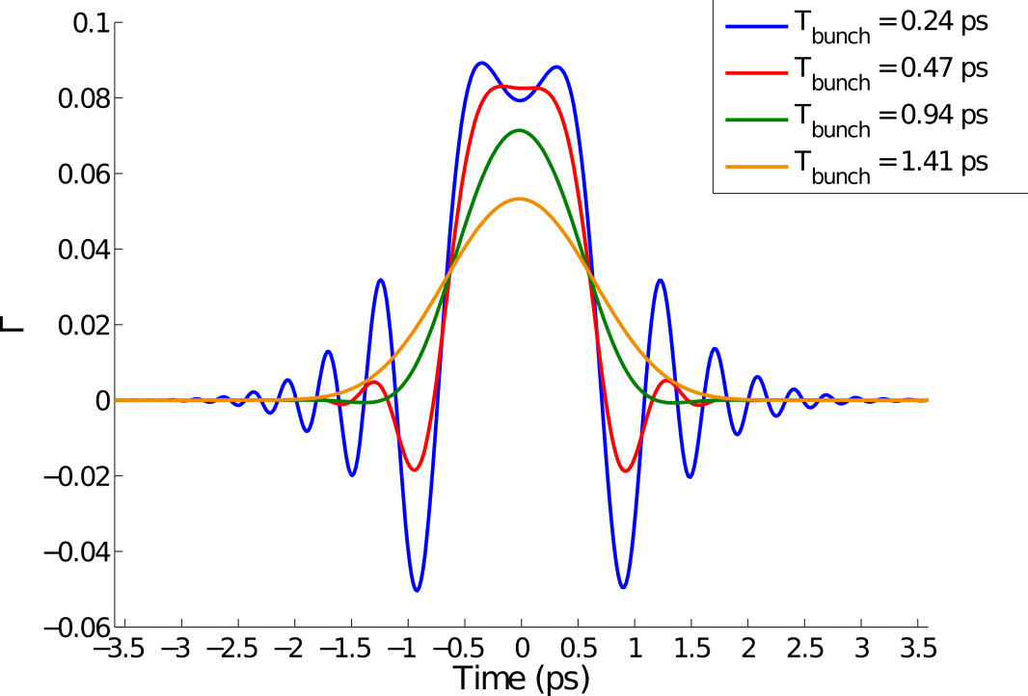
Measurements – Resolution Limit
Steep edges -> Oscillations occur
Frequency mixing
Simulations have been done, here with gaussian bunches
Laurens Wissmann – EO@BC2 – Page 15/18
Notes:
Frequency mixing distorts signal if THz pulse has steep features (corresponding to high frequency components).

Slide 16
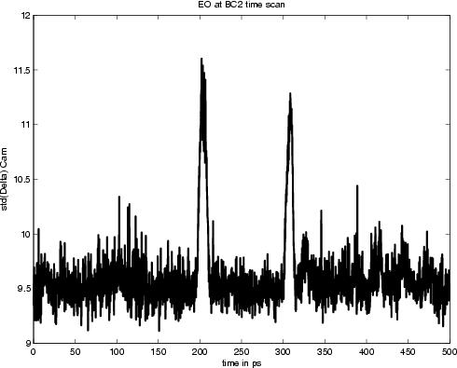
EO@BC2 – Upgrade (2011 Easter Shutdown)
Crystal exchange
  0.5 mm GaP -> 5 mm GaP
  stronger phase retardation (larger signal)
  Shift of the reflection artifact from 11 ps to 110 ps
Longer optical fibre
  Stronger chirped pulses (7 ps -> 10 ps)
  Enhamncement of the detector range
Trigger enhancement board integrated
  Less timing jitter for the optical gating
  Decrease of amplitude jitter
Laser had to be returned a second time
Laurens Wissmann – EO@BC2 – Page 16/18

Slide 17
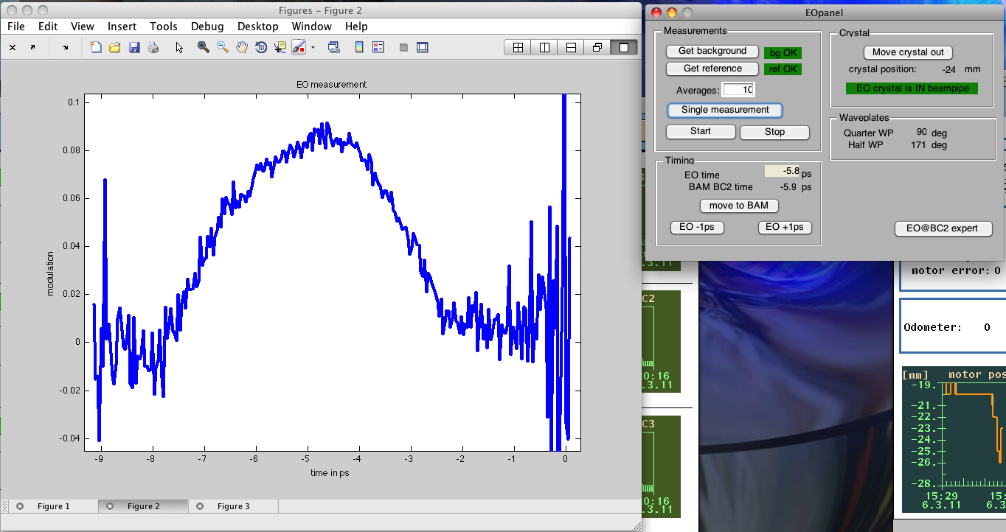
EO@BC2 – Current Status and Outlook
Hardware
  Monitor proved to work as planned
  Resolution sufficient for long bunches after BC2
Software
  All measurements were taken with MATLAB scripts -> not user friendly
  A Matlab GUI is available -> more user friendly
  A dedicated DOOCS server is being developped -> operator tool
Future perspective
  Useful tuning tool, for example, for tailored bunches
  Minor changes might be interesting (integrating a pulse compressor in the frontend)
  The frontend will be a part of the XFEL diagnostics, with a different laser system
Laurens Wissmann – EO@BC2 – Page 17/18

Slide 18
The End
Thank you for your attention.
…any questions?

